Slide 1


Ten #Failed Forecasting Plan Assumptions
By Troy Magennis
@t_magennis
FocusedObjective.com

Slide 2


Slide 3
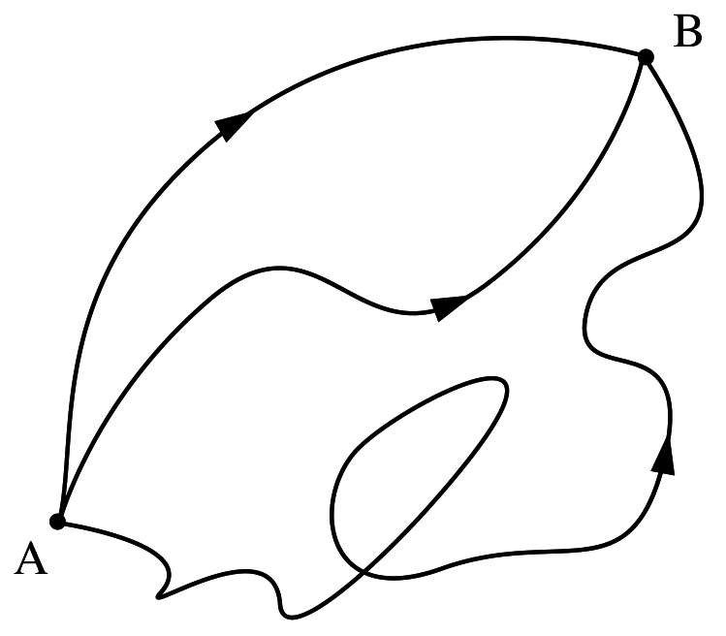
Option1
Option 1 & 2 need analysis, or do they?
Option2
Option3
> 2x Option 3 is excluded

Slide 4


Slide 5


Slide 6
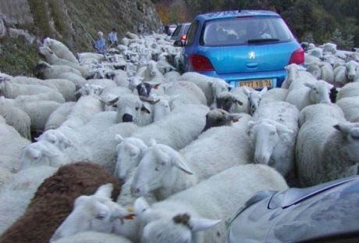

Slide 7
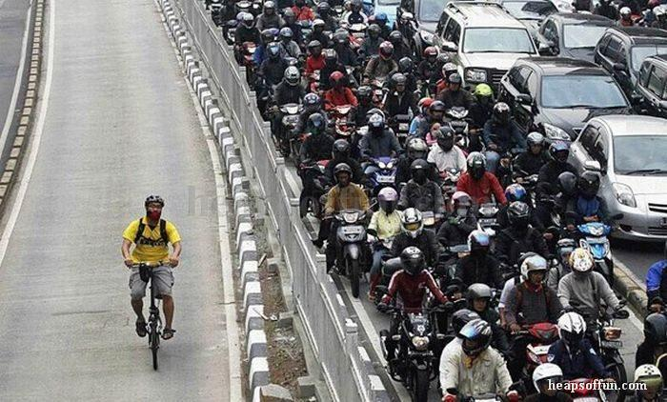

Slide 8
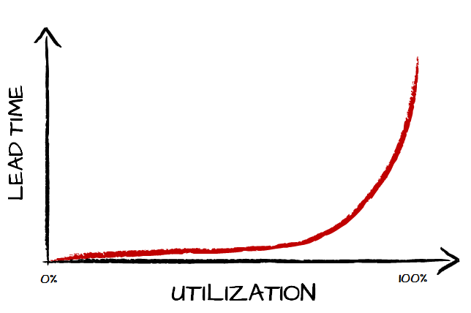
Item Estimation ALWAYS Fails
Item Estimation SOMETIMES works
See full story at http://brodzinski.com/2015/01/slack-time-value.html

Slide 9
Can’t forecast high utilization systems using item size
Trucks move at same speed as cars

Slide 10
Network Throughput Test
Slides and spreadsheets at
Bit.ly/SimResources
(Case SENSITIVE)

Slide 11
For high utilization systems we need to track system level impediments
“Things that impact EVERY item”
And “System Utilization”

Slide 12


1: Missed Start Date
Mistake when planning portfolios

Slide 13
1: Missed Start Date Actual Start Date > Planned Start
How the planned date was chosen?
Who signs off on the decision to do this project?
Causes of past delays?
Possible delays of this project?
Give estimates as duration rather than end-date
Keep history of planned date versus start date delay
Model start date risk using the historical range of delays

Slide 14
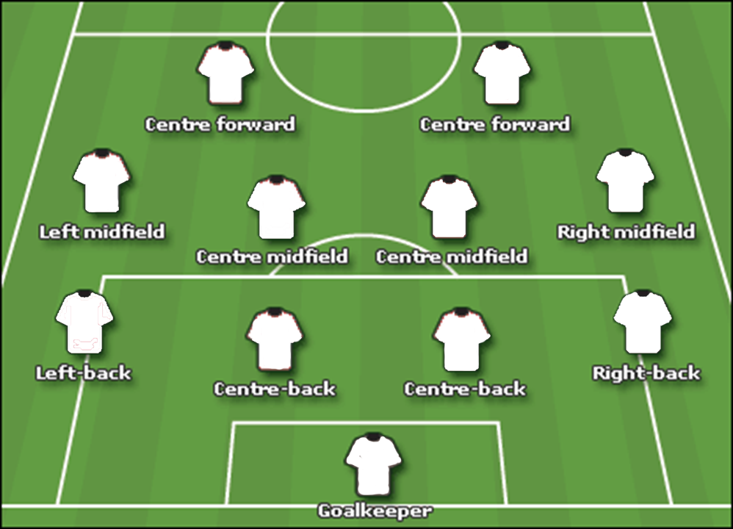
2: No Team (Team not ready)

Slide 15
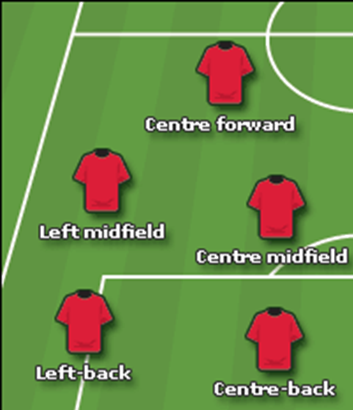

3: Partial Team (Team < planned)

Slide 16
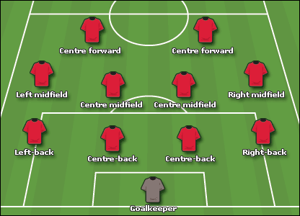


4: Partial Body Staffing

Slide 17

5: Missing Skillsets

Slide 18
3, 4 & 5: Team Skill and Strength
How were the skill-sets required determined
Did skill level factor into team planning
What other duties do the planned staff perform (production support, etc.)
How ramp up time for new members is considered
Plan what skills are necessary for the project
Perform Capability Matrix to find skill gaps and resolve
Estimate and plan how long it takes from “hire to productive” for skills
Only plan using “productive date” (not the hire date)

Slide 19
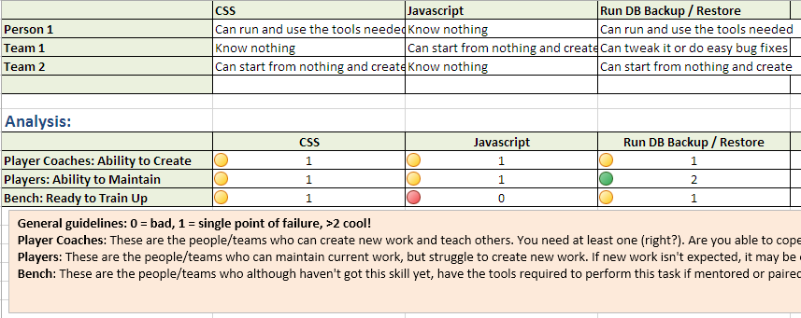
Capability Matrix
Bit.ly\SimResources

Slide 20

Amdahl's Law indicates that the speedup from parallelizing any computing problem is inherently limited by the presence of serial (non-parallelizable) portions

Slide 21
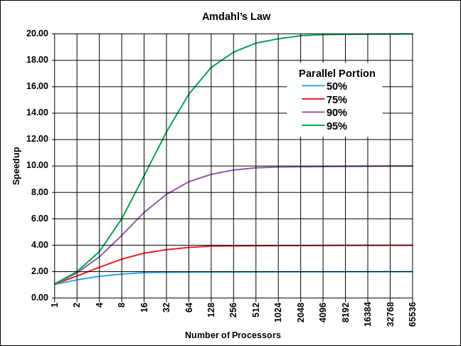
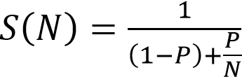
6: Overstated Parallel Effectiveness
8 parallel teams with 75% parallelizable work = 3x

Slide 22

7: Dependencies and Friction
Amdahl was an Optimist
Error for high team count

Slide 23
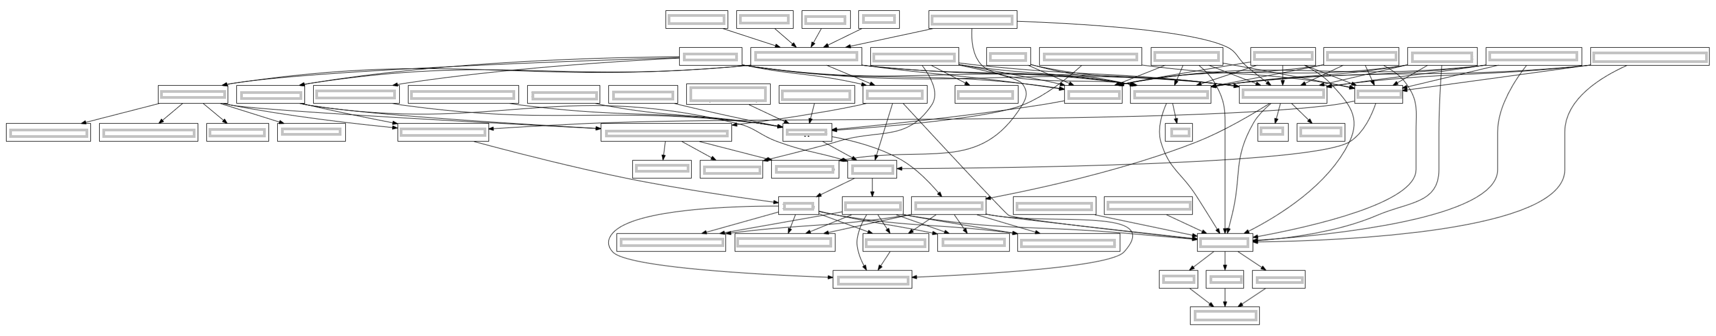
1
2
3
4
5
6
7
Team Dependency Diagram

Slide 24
Chances at least one team not delayed
1 in 2^{n} ^{or}
1 in 2⁷
^{or}
1 in 128

Slide 25
7 dependencies
1 chance in 128

Slide 26
6 dependencies
1 chance in 64

Slide 27
5 dependencies
1 chance in 32

Slide 28
7: Dependency Impacts Your timetable != Someone else’s
Determine complexity in build order dependencies
Determine is-aligned priorities
Determine what incentives are in place
Look for re-organization opportunities to reduce dependencies
Reduce batch sizes
Communicate initial and updated information often
Build incentives to align priorities

Slide 29

Defects
Technical Debt
Mistake for startups & older systems
8: Carried over defects and debt

Slide 30

9: Ship Stoppers

Slide 31
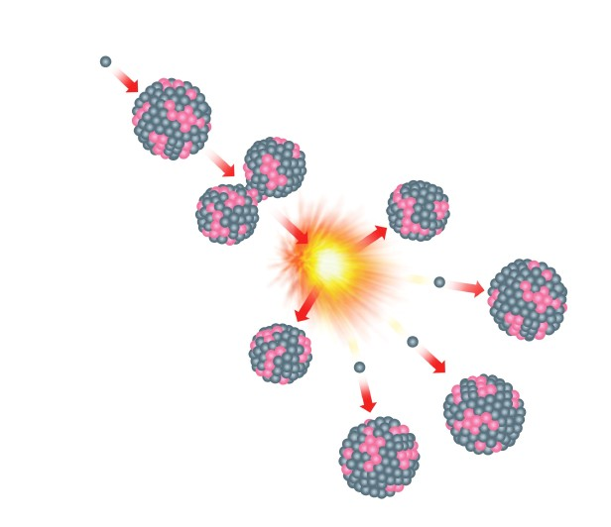
10: Splitting
Product Backlog
Mistake when forecasting using data
Historical throughput/velocity based on pre and post split work
Sprint Backlog

Slide 32


Forecast
Assumption 1
Assumption 2
Assumption 3
Assumption …
Assumption n

Slide 33
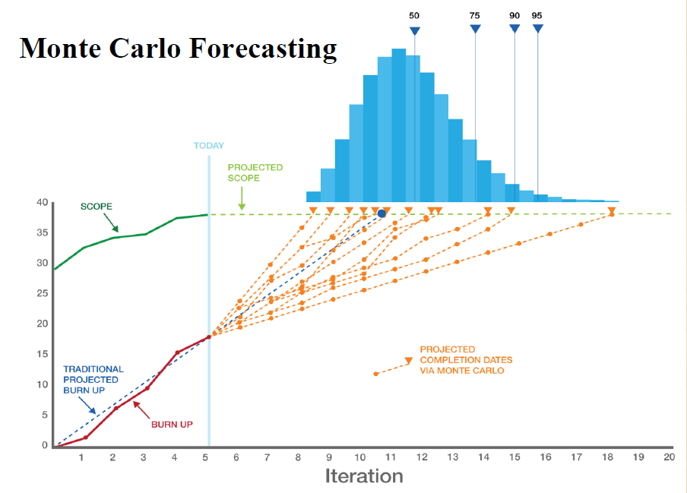

Image thanks to Larry Maccherone

Slide 34
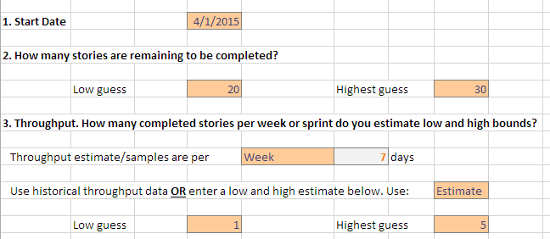
What is this chart?
This chart shows the simulated burn-down trends. It shows the first 50 trials and visually shows the general hotspots and outlier dates.
Bit.ly\SimResources

Slide 35




Calls to action…
Understand when estimation is NOT needed
Track failed assumptions not work item status
Build achievable plans and goals
Free tools / Spreadsheets / Exercises Bit.ly/SimResources
Twitter: @t_magennis
Email: troy.magennis@focusedobjective.com

Slide 36
Ten #Failed Forecasting Plan Assumptions
By Troy Magennis
@t_magennis
FocusedObjective.com

Slide 38
Option1
Option 1 & 2 need analysis, or do they?
Option2
Option3
> 2x Option 3 is excluded

Slide 39
Nirvana
Staff driven
Cost driven
Risk driven
Flexible
Ability to alter investment once committed
Fixed
Low Loss
High Loss
Penalty of being late – lost revenue, etc.
Notes:
Ability to alter budget or investment once committed
Upfront costs to start the project/feature
Penalty of being late or not knowing early enough

Slide 40
Network Throughput Test
Slides and spreadsheets at
Bit.ly/SimResources
(Case SENSITIVE)

Slide 45
Item Estimation Fails
Item Estimation works
See full story at http://brodzinski.com/2015/01/slack-time-value.html

Slide 46
Can’t forecast high utilization systems using item size
Trucks move at same speed as cars

Slide 47
For high utilization systems we need to track system level impediments
“Things that impact EVERY item”
“System Utilization”

Slide 48
For the same distance:
Time of Day
Day of week
Multiple lanes?
Traffic lights (luck, #)
Other drivers (stupidity)
Weather / Road conditions

Slide 49
For the same project:
When we start
Time of year/season
Number of teams/people
Dependencies
Other project timelines
Interruptions

Slide 50
1: Missed Start Date
Mistake when planning portfolios

Slide 51
1: Missed Start Date Actual Start Date > Planned Start
Planned Start
Actual Start
December
January
February
March
2 Month Delay
Decision Delay

Slide 52
1: Missed Start Date Actual Start Date > Planned Start
How the planned date was chosen?
Who signs off on the decision to do this project?
Causes of past delays?
Possible delays of this project?
Give estimates as duration rather than end-date
Keep history of planned date versus start date delay
Model start date risk using the historical range of delays

Slide 53
2: No Team (Team not ready)

Slide 54
2: Team Not “Ready” at Start Date Actual Team = 0
Planned Start
Possible Start
Actual Start
December
January
February
March
3 Month Delay
Team Delay

Slide 55
2: Team Not “Ready” at Start Date Actual Team = 0
Is the team in place already? Can I see them?
What are they working on now? Is it likely to be delayed?
Higher priority projects?
Plans to hire aren’t always achievable by given date
Plan environment factors: space to sit, equipment, meeting space
What infrastructure does the team need to “start” work?

Slide 56
3: Partial Team (Team < planned)

Slide 57
3: Team Not at Strength Actual Team < Planned Team
Planned Start
Possible Start
Actual Start
December
January
February
March
3 Month Delay
Team Delay

Slide 58
4: Partial Body Staffing

Slide 59
4: Partial Body Staffing Actual Team “sometimes =” Planned
Planned Start
Possible Start
Oops!
Track interruptions
December
January
February
March
Team Delay

Slide 60
5: Missing Skillsets

Slide 61
5: Team Does Not Have Needed Skills Actual set(skills) < planned set(skills)
Planned Start
Possible Start
Full Strength!
December
January
February
March
CSS / JavaScript
Java / C#
Team Delay

Slide 62
3, 4 & 5: Team Skill and Strength
How were the skill-sets required determined
Did skill level factor into team planning
What other duties do the planned staff perform (production support, etc.)
How ramp up time for new members is considered
Plan what skills are necessary for the project
Perform Capability Matrix to find skill gaps and resolve
Estimate and plan how long it takes from “hire to productive” for skills
Only plan using “productive date” (not the hire date)

Slide 63
Capability Matrix

Slide 64
Amdahl's Law indicates that the speedup from parallelizing any computing problem is inherently limited by the presence of serial (non-parallelizable) portions

Slide 65
6: Overstated Parallel Effectiveness
8 parallel teams with 75% parallelizable work = 3x

Slide 66
6: Overstating Parallel Scalability Actual Benefit < Assumed Benefit
Amdahl's Law indicates that the speedup from parallelizing any computing problem is inherently limited by the presence of serial (non-parallelizable) portions
Team 1
Team 2
Idea
Planning / Pre “Go” Decision
Integration / Distribution
Customer
Team 3
Team n
Serial
Parallel
Serial

Slide 67
6: Overstating Parallel Scalability Actual Benefit < Assumed Benefit
What are the serial parts of a complete system path (often shared resources)
How do teams plan to integrate work
How do team co-ordinate and plan work
What are the inter-dependencies between teams
Find ways to eliminate serial paths
Track and prioritize fixing blockers in serial paths
Organize teams to reduce inter-dependencies
Remind people non-linearity of parallel scaling

Slide 68
7: Dependencies and Friction
Amdahl was an Optimist
Error for high team count

Slide 69
1
2
3
4
5
6
7
Team Dependency Diagram

Slide 70
Chances at least one team not delayed
1 in 2^{n} ^{or}
1 in 2⁷
^{or}
1 in 128

Slide 71
7 dependencies
1 chance in 128

Slide 72
6 dependencies
1 chance in 64

Slide 73
5 dependencies
1 chance in 32

Slide 74
7: Dependency Impacts Your timetable != Someone else’s
Determine complexity in build order dependencies
Determine is-aligned priorities
Determine what incentives are in place
Look for re-organization opportunities to reduce dependencies
Reduce batch sizes
Communicate initial and updated information often
Build incentives to align priorities

Slide 75
Defects
Technical Debt
Mistake for startups & older systems
8: Carried over defects and debt

Slide 76
9: Ship Stoppers

Slide 77
10: Splitting
Product Backlog
Mistake when forecasting using data
Historical throughput/velocity based on pre and post split work
Sprint Backlog

Slide 78
Forecast
Assumption 1
Assumption 2
Assumption 3
Assumption …
Assumption n

Slide 79
Image thanks to Larry Maccherone

Slide 80
What is this chart?
This chart shows the simulated burn-down trends. It shows the first 50 trials and visually shows the general hotspots and outlier dates.
Bit.ly\SimResources

Slide 81
Calls to action…
Understand when estimation is NOT needed
Track failed assumptions not work item status
Build achievable plans and goals
Free tools / Spreadsheets / Exercises Bit.ly/SimResources
Twitter: @t_magennis
Email: troy.magennis@focusedobjective.com

Slide 82
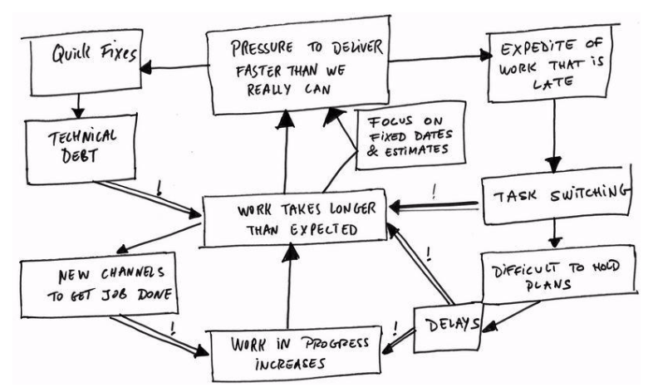
Brilliant!

Slide 83
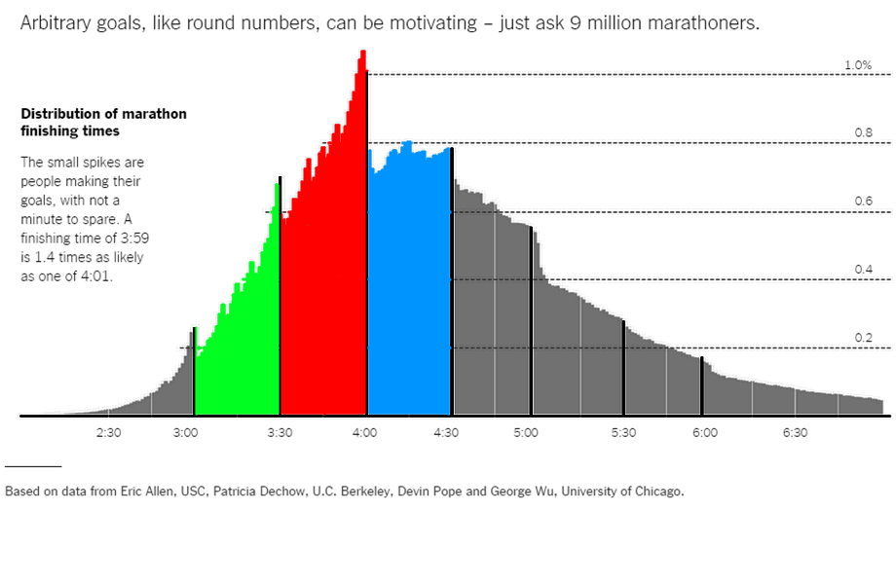
3:59 is 1.4x more likely than 4:01
Source: NYT: http://www.nytimes.com/interactive/2014/04/22/upshot/100000002835671.mobile.html?abt=0002&abg=1&_r=0

Slide 84
My Definitions
Guess = no information, just thrown out there
Measurement = Reduction of uncertainty
Estimate = A predicted measure
Regression (Forecast) = Estimate by trend
Probabilistic Forecast = A set of estimates
Can be a range (from – to)
Can be a probability distribution
Can be a single value at an agreed probability

Slide 85


“Expert” Guess
“Expert” Range Guess
Regression Forecast
Trend based extrapolation
(mathematical)
Probabilistic Forecast
Distribution based
(statistical)
Guesses may be based on data and/or experience
Not About Use of Data

Slide 86
Planned Team

Slide 87
Ten Reasons
Things affecting all items more than any one
Staff related issues impact ALL work
System related issues impact ALL work
Its not that there isn’t uncertainty in the work, its just the uncertainty in the system has more impact
For example
Time of day impacts my commute time more than what vehicle I’m in – Farrari’s aren’t faster in a gridlock conditions

Slide 88
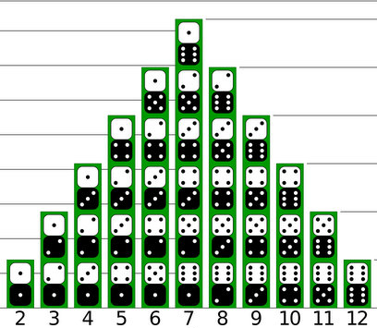





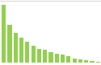
Distribution Arithmetic
Max 12
Uniform
Uniform
to
to
Max 36
to
to

Slide 89
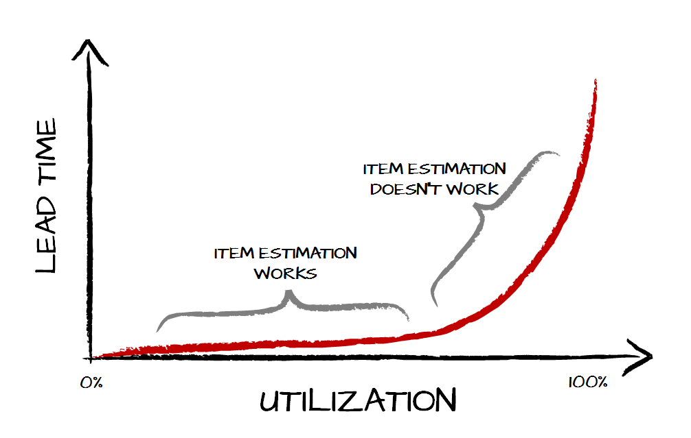
See full story at http://brodzinski.com/2015/01/slack-time-value.html

Slide 90
Distribution Arithmetic
Max 12
Uniform
Uniform
to
to
Max 36
to
to

